Slide 1

Data Models

Slide 2

Data Models
Data modeling is the first step in the database design journey, serving as a bridge between real-world objects and the computer database.

Slide 3
View on Data
designers, programmers, and end users see data in diﬀerent ways
diﬀerent views of the same data can lead to database designs that do not reﬂect an organization’s actual operation

Slide 4
Avoiding failure
database designers must obtain a precise description of the data’s nature and many uses within the organization
Communication among database designers, programmers, and end users should be frequent and clear
Data modeling clarifies such communication by reducing the complexities of database design to more easily understood abstractions that define entities, relations, and data transformations

Slide 5

Data Modelling and Data Models
Database design focuses on how the database structure will be used to store and manage end-user data.

Slide 6
Data Modelling
Data modeling - refers to the process of creating a specific data model for a determined problem domain.
Data model - is a relatively simple representation, usually graphical, of more complex real-world data structures.

Slide 7
A problem domain is a clearly defined area within the real-world environment, with a well-defined scope and boundaries that will be systematically addressed
a model is an abstraction of a more complex real-world object or event. A model’s main function is to help you understand the complexities of the real-world environment.

Slide 8
Data modeling is an iterative, progressive process.
Start with a simple understanding of the problem domain, and as your understanding increases, so does the level of detail of the data model.
When done properly, the final data model eﬀectively is a “blueprint” with all the instructions to build a database that will meet all end-user requirements.
This blueprint is narrative and graphical in nature, meaning that it contains both text descriptions in plain, unambiguous language and clear, useful diagrams depicting the main data elements.

Slide 9
Importance of Data Models
Data models can facilitate interaction among the designer, the applications programmer, and the end user.
A well-developed data model can even foster improved understanding of the organization for which the database design is developed.

Slide 10
Data Model Basic Building Blocks
Entity
Attribute
Relationship
Constraint
Business Rule

Slide 11
Entity
An entity is a person, place, thing, or event about which data will be collected and stored.
An entity represents a particular type of object in the real world, which means an entity is “distinguishable”—that is, each entity occurrence is unique and distinct.

Slide 12
Attribute
An attribute is a characteristic of an entity.
Attributes are the equivalent of fields in file systems.

Slide 13

Relationship
A relationship describes an association among entities.
One to Many
Many to Many
One to one

Slide 14
Constraint
A constraint is a restriction placed on the data.
Constraints are important because they help to ensure data integrity.
Constraints are normally expressed in the form of rules

Slide 15
Business Rule
A business rule is a brief, precise, and unambiguous description of a policy, procedure, or principle within a specific organization.
• A customer may generate many invoices. • An invoice is generated by only one customer. • A training session cannot be scheduled for fewer than 10 employees or for more than 30 employees.

Slide 16
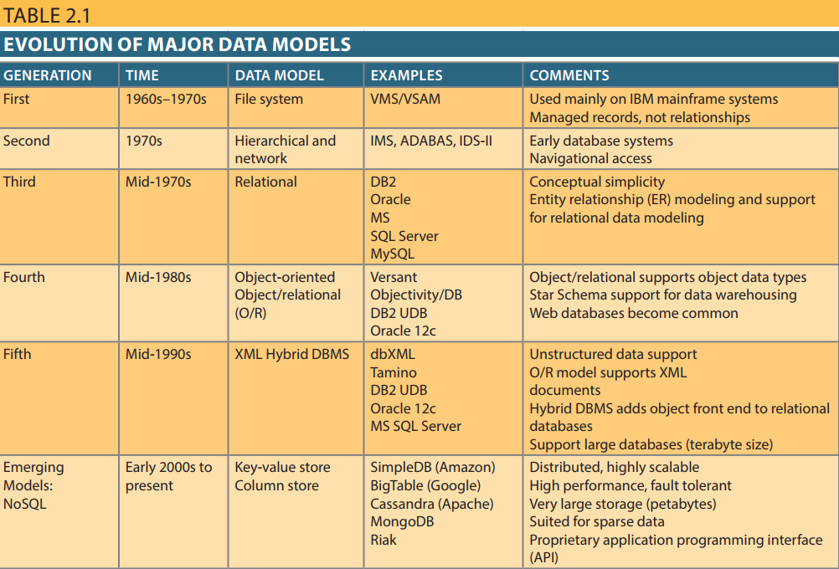
Evolution of Data Models

Slide 17
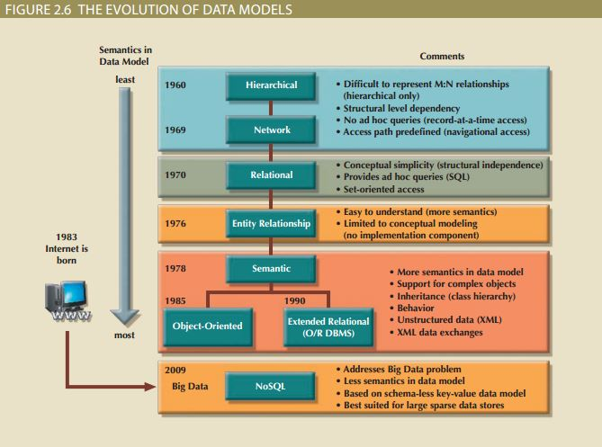
The Evolution of Data Models Summary Illustration

Slide 18
Relational Databases

Slide 19
Characteristics
Allows the designer to focus on the logical representation of the data and its relationships rather than physical storage details
The relational model enables you to view data logically rather than physically.

Slide 20
Tables
A table is perceived as a two-dimensional structure composed of rows and columns.
A table is also called a relation because the relational model’s creator, E. F. Codd, used the two terms as synonyms.

Slide 21
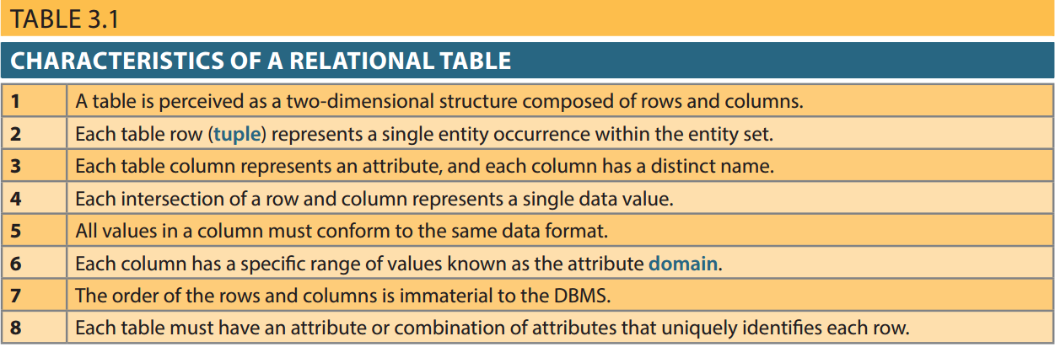

Slide 22
Keys
In the relational model, keys are important because they are used to ensure that each row in a table is uniquely identifiable.
They are also used to establish relationships among tables and to ensure the integrity of the data.
A key consists of one or more attributes that determine other attributes..

Slide 23
Dependencies
The role of a key is based on the concept of determination.
Determination is the state in which knowing the value of one attribute makes it possible to determine the value of another

Slide 24
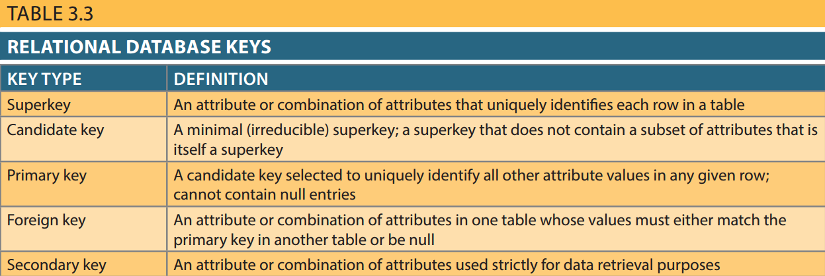
Types of Keys

Slide 25
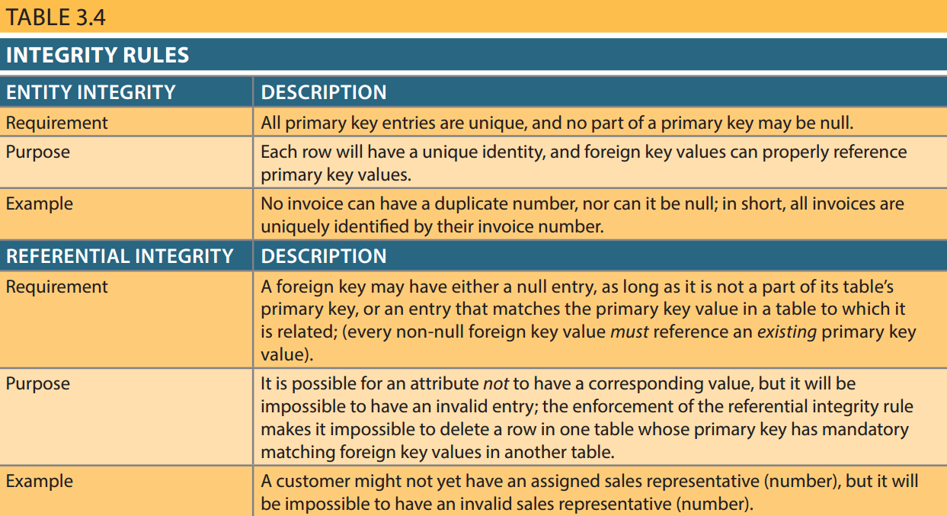
Integrity Rules

Slide 26
Data Dictionary
The data dictionary provides a detailed description of all tables in the database created by the user and designer.
Thus, the data dictionary contains at least all of the attribute names and characteristics for each table in the system.
In short, the data dictionary contains metadata—data about data.

Slide 27
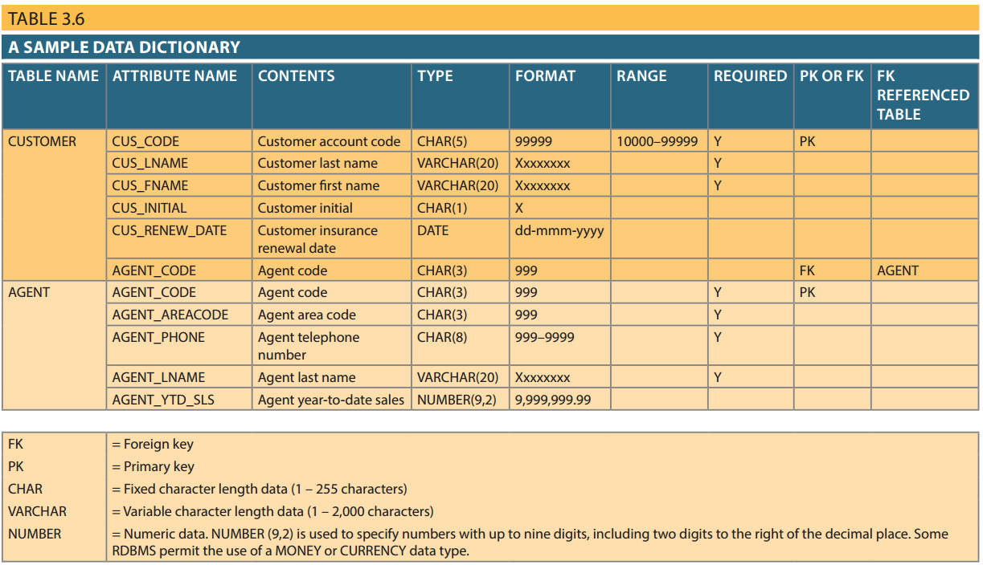

Slide 28
System Catalog
Like the data dictionary, the system catalog contains metadata.
The system catalog can be described as a detailed system data dictionary that describes all objects within the database, including data about table names, table’s creator and creation date, number of columns in each table, data type corresponding to each column, index filenames, index creators, authorized users, and access privileges.

